Slide 1

Predicting Fatalities: NYPD Shooting Incident Model
Enhancing Public Safety with Predictive Analytics

Slide 2
Objective
1. Introduction
•Brief Overview: Our project aims to develop a predictive model for fatal outcomes in NYPD shooting incidents. By leveraging historical data and advanced analytics, we seek to identify high-risk situations and enhance public safety.
2. Key Points
•Predict Fatalities: Utilize historical data to forecast the likelihood of fatal outcomes in shooting incidents.
•Enhance Public Safety: Identify patterns and trends to help law enforcement proactively address high-risk situations.
•Data-Driven Decisions: Support informed decision-making processes through advanced analytics.
3. Importance
•Significance: Predictive modeling plays a crucial role in reducing fatalities and improving public safety, making this project an essential step towards safer streets.

Slide 3
Data Overview
Number of records:
Our dataset comprises a robust collection of data, consisting of over 27,000 records. Each record represents a unique shooting incident, contributing to the richness and depth of our analysis.
Features/Columns:
The dataset is characterized by a diverse set of features, each providing valuable insights into shooting incidents, their locations, and outcomes. In total, there are 21 features/columns that form the basis of our predictive modeling.
Source of the Data:
The dataset is sourced from the New York Police Department (NYPD), provided by the institute, ensuring reliability and relevance. The data's origin plays a crucial role in shaping the context and ensuring that our analysis is grounded in real-world scenarios and industry dynamics.

Slide 4
Key Features
1.incident_key - Randomly generated persistent ID for each arrest
2. occur_date - Exact date of the shooting incident
3. occur_time - Exact time of the shooting incident
4. boro - Borough where the shooting incident occurred
5. loc_of_occur_desc - (no description provided)
6. precinct - Precinct where the shooting incident occurred
7. jurisdiction_code - Jurisdiction where the shooting incident occurred. Jurisdiction codes 0(Patrol), 1(Transit) and 2(Housing) represent NYPD whilst codes 3 and more represent non NYPD jurisdictions
8. loc_classfctn_desc - (no description provided)
9. location_desc - Location of the shooting incident
10. statistical_murder_flag - Shooting resulted in the victim's death which would be counted as a murder

Slide 5
Key Features
11. perp_age_group - Perpetrator's age within a category
12. perp_sex - Perpetrator's sex description
13. perp_race - Perpetrator's race description
14. vic_age_group - Victim's age within a category
15. vic_sex - Victim's sex description
16. vic_race - Victim's race description
17. x_coord_cd - Midblock X-coordinate for New York State Plane Coordinate System, Long Island Zone, NAD 83, units feet (FIPS 3104)
18. y_coord_cd - Midblock Y-coordinate for New York State Plane Coordinate System, Long Island Zone, NAD 83, units feet (FIPS 3104)
19. latitude - Latitude coordinate for Global Coordinate System, WGS 1984, decimal degrees (EPSG 4326)
20. longitude - Longitude coordinate for Global Coordinate System, WGS 1984, decimal degrees (EPSG 4326)
21. Lon_Lat (geocoded_column) - Longitude and Latitude Coordinates for mapping

Slide 6
Data Preprocessing
1. Cleaning
Handling Missing Values: Handled missing values using forward fill to maintain data consistency data.fillna(method='ffill')).
Removing Duplicates: Removed duplicate rows to ensure data integrity(data = data.drop_duplicates()).
Drop Null Values: Dropped rows where 'STATISTICAL_MURDER_FLAG' was missing.(data = data.dropna(subset=['STATISTICAL_MURDER_FLAG'])).
2. Encoding Categorical Variables
Label Encoding: Applied label encoding to convert categorical features into numeric format for model compatibility.(le = LabelEncoder()).
3. Addressing Class Imbalance
SMOTE: Utilized SMOTE to generate synthetic samples, ensuring balanced class distribution.(smote = SMOTE(random_state=42)).
4. Feature Scaling
Standard Scaling:Standardized numerical features to have a mean of 0 and a standard deviation of 1, facilitating better model performance.(scaler = StandardScaler()).

Slide 7
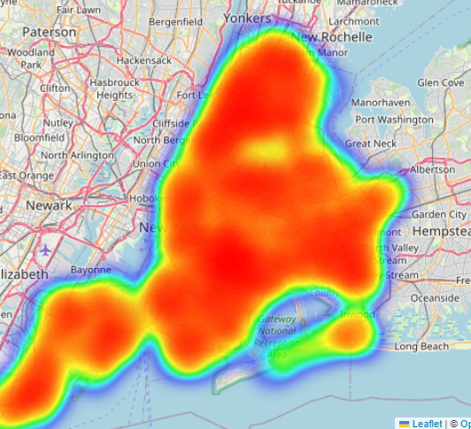
Exploratory Data Analysis
EDA is a crucial step in data analysis where we explore and visualize data to uncover patterns, spot anomalies, test hypotheses, and check assumptions.
a. Heatmap of Shooting Incidents
Description: This heatmap visualization provides a clear and interactive way to identify hotspots of shooting incidents. It highlights areas with a higher concentration of shootings, allowing for targeted interventions.
Information Provided: The map shows where shootings are most frequent, helping to focus resources and strategies on high-risk areas.

Slide 8
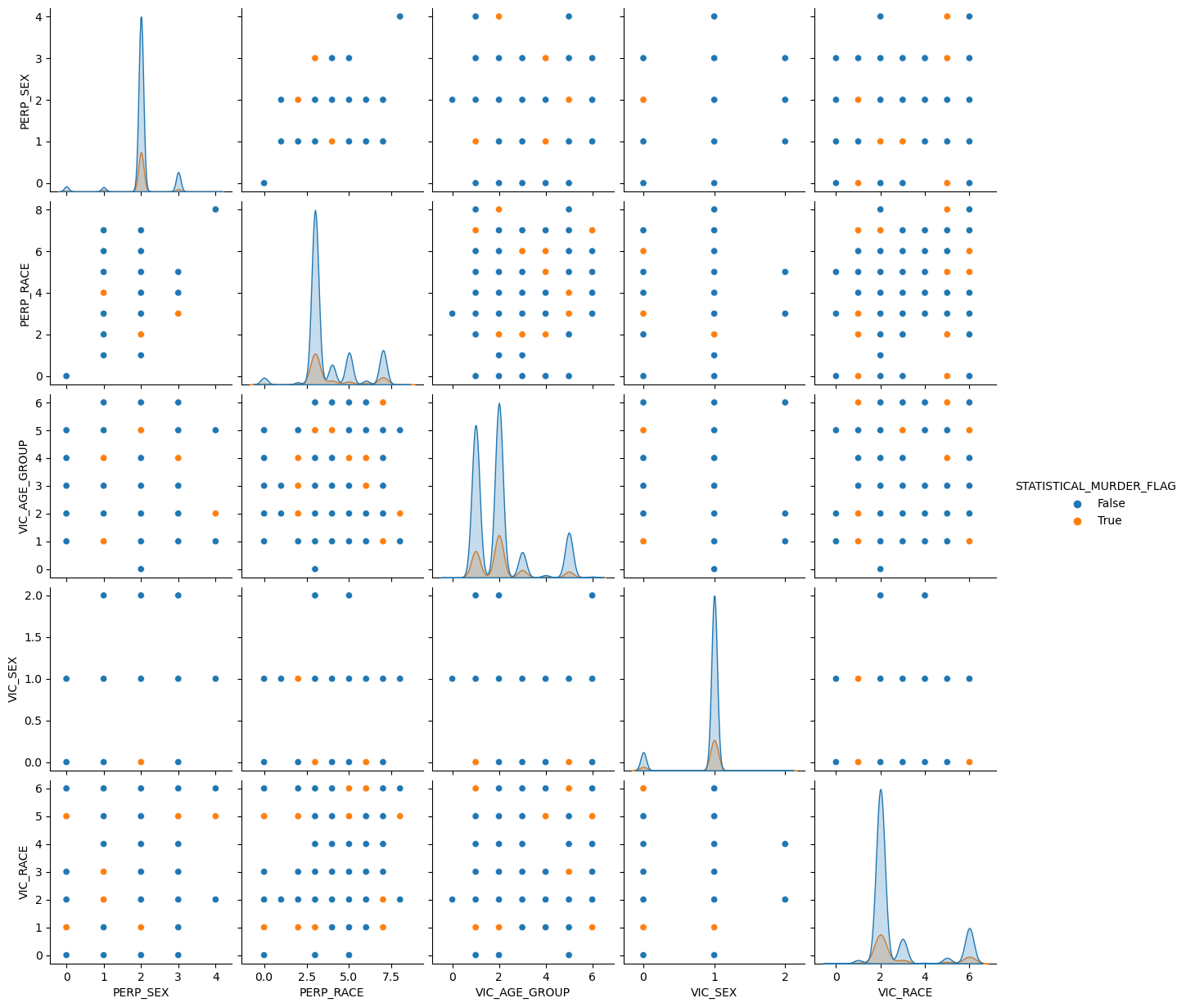
Key Relationships and Insights
This pair plot visualizes relationships between key demographic features (sex, race, age group of perpetrators and victims) and the fatality of shooting incidents (STATISTICAL_MURDER_FLAG). Color-coded for fatal (orange) and non-fatal (blue) incidents, the scatter plots show interactions between pairs of features, while the diagonal plots display their distributions.
Male perpetrators and victims are the majority in both fatal and non-fatal incidents.
Black and Hispanic races are more frequently involved in fatal incidents, both as perpetrators and victims.
The 25-44 age group of victims shows a higher association with fatal outcomes.

Slide 9
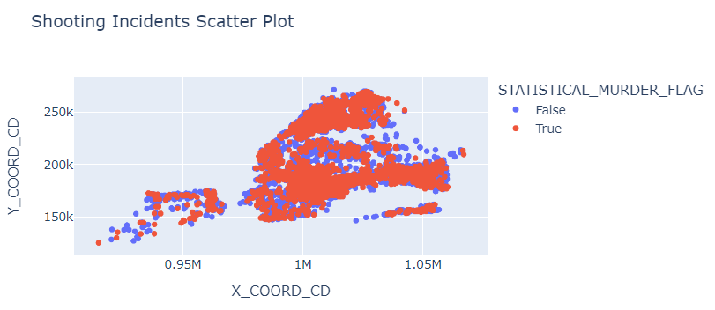
Geographic Insights from Incident
This interactive scatter plot lets you see where shooting incidents happened. By hovering over each point, you can get more details like the borough and time of the incident. It helps you spot trends and problem areas in a clear, visual way.
Geographic Insights: Understand where shooting incidents are happening, with a clear distinction between fatal and non-fatal incidents.
Contextual Data: Gain additional information about each incident, such as its borough and time.
Hotspot Identification: Identify specific areas requiring focused law enforcement or community interventions.

Slide 10
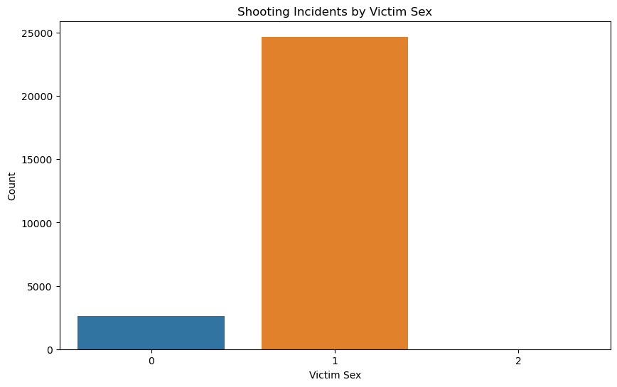
Shooting Incident by Victim Sex
This slide effectively communicates the demographic impact of shooting incidents based on victim sex, guiding targeted interventions and resource allocation.
Victim Sex Distribution: The graph highlights the disparity in the number of shooting incidents based on victim sex, with Category 1 being the most affected.
Incident Patterns: Provides a clear view of which victim sex categories experience higher or lower frequencies of shooting incidents.

Slide 11
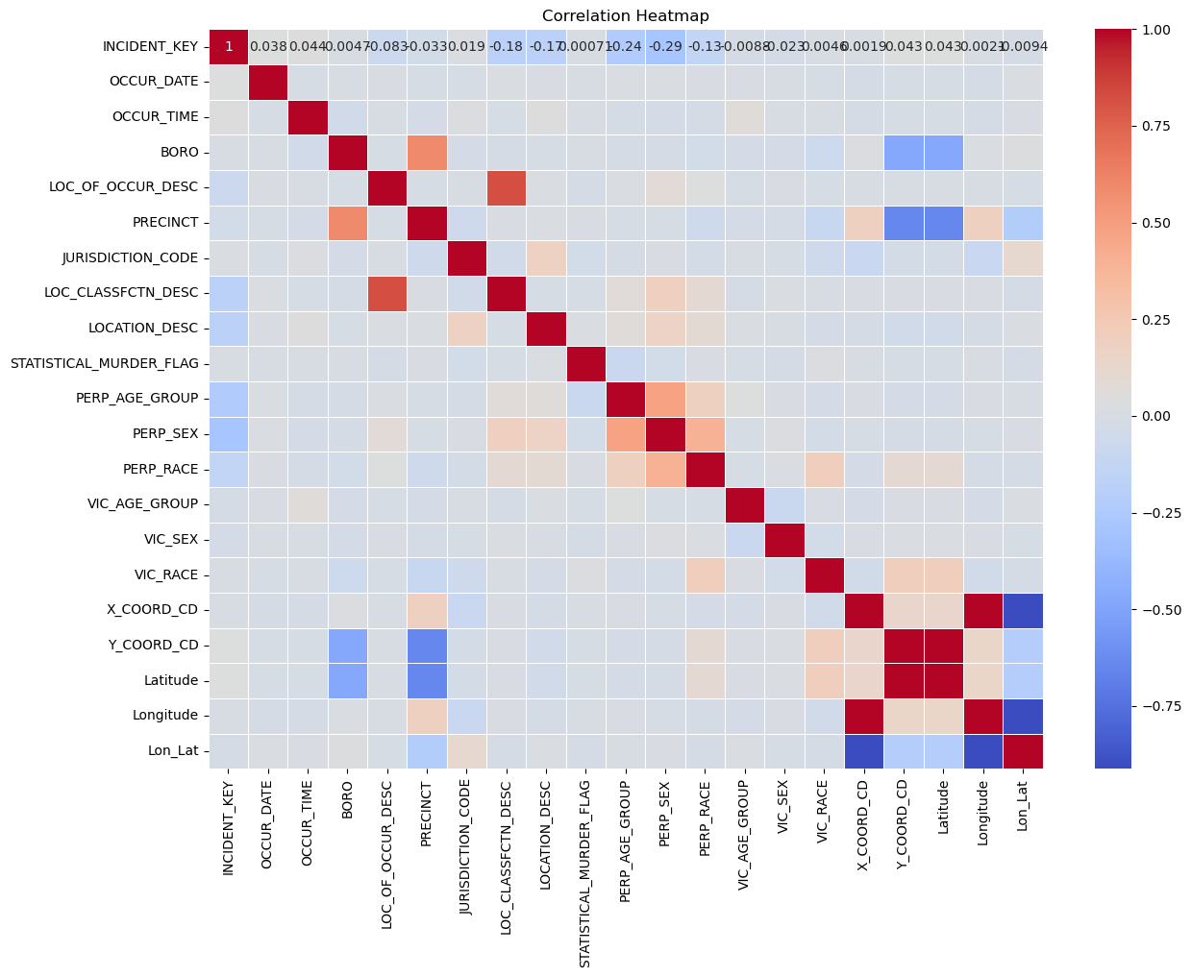
Correlation Heatmap
visualization helps identify which features in your dataset are strongly correlated with each other
Relationship Identification: The heatmap displays correlation coefficients, showing positive (red) and negative (blue) relationships between variables, with values ranging from -1 to 1.
Significant Correlations: Highlights which variables have strong positive or negative correlations, indicating direct or inverse relationships.
Feature Selection and Simplification: Guides feature selection for the predictive model by identifying significant interactions and potential redundant features.

Slide 12
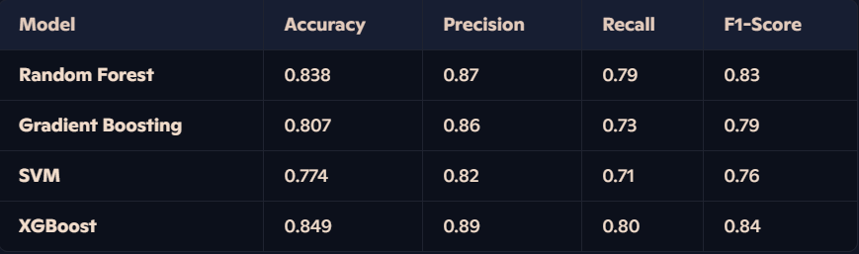
Model Performance Comparison
This table compares the performance of different models on key metrics, highlighting XGBoost as the top-performing model for predicting shooting incident fatalities.
Random Forest: Shows strong overall performance with high precision.
Gradient Boosting: Balanced performance, slightly lower than Random Forest.
SVM: Lower performance across metrics compared to other models.
XGBoost: Highest accuracy and strong performance across all metrics, making it the best model.

Slide 13
Cross-Validation Performance
Crossvalidation provides a robust measure of model performance by partitioning the data into multiple subsets and evaluating the model on each.
Mean Accuracy: Achieved a mean accuracy of 0.7732, indicating consistent predictive power across different data splits.
Standard Deviation: A low standard deviation of 0.0170 suggests that the model's performance is stable and not highly variable.

Slide 14
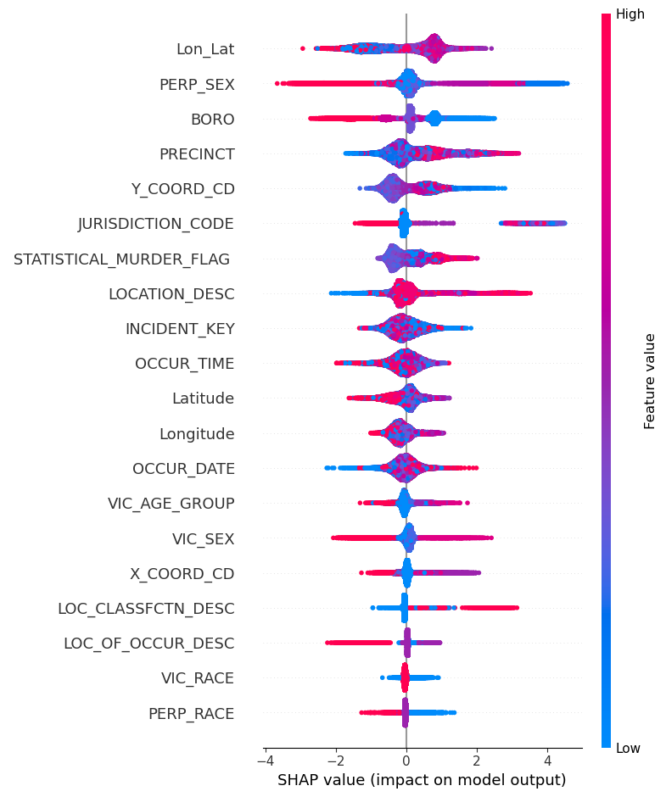
Feature Importance Analysis with SHAP
Feature Importance: This SHAP summary plot reveals which features are most influential in predicting shooting incident fatalities.
Model Transparency: It enhances model transparency by showing how each feature affects the predictions.
Guidance for Improvement: Insights from this plot can guide further model refinement and feature engineering.
Color Coding: Blue dots (low values) and red dots (high values) indicate the feature's value and its impact direction on the model output.

Slide 15
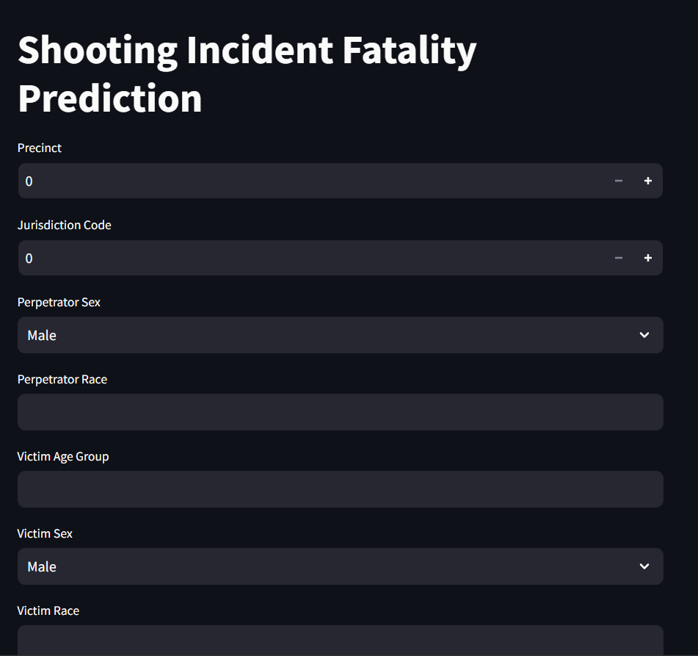
Conclusion
Developed a robust model that accurately predicts shooting incident fatalities using key demographic and location-based features.
XGBoost emerged as the topperforming model with an accuracy of 84.92%, demonstrating strong predictive power and consistency across cross-validation.
This model can be instrumental for law enforcement agencies to identify high-risk situations and allocate resources effectively to prevent fatalities.

Slide 16
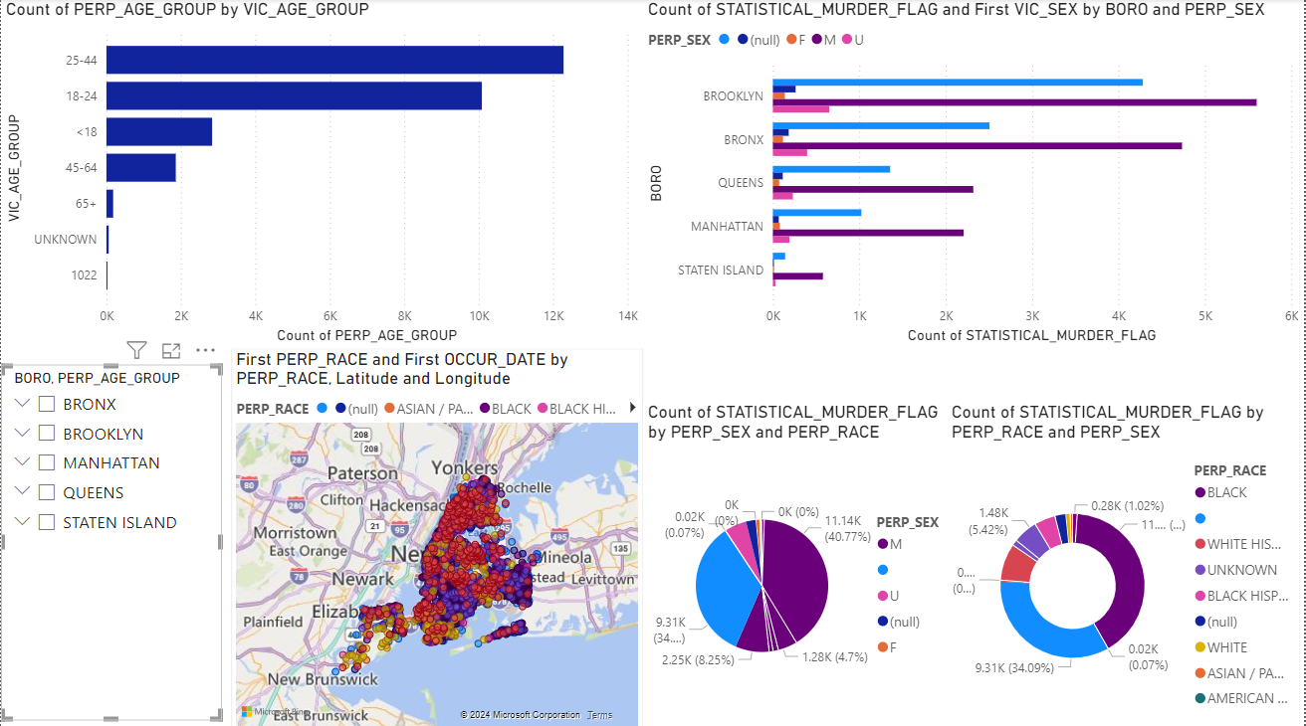
Power BI Dashboard Overview
Bar charts show incident distribution by age group.
Pie charts break down incidents by sex and race.
Map visualizes crime hotspots and concentrated areas.

